Slide 1
Innovative Projects Using Raspberry Pi (ECE2011)
Phase –III Review Presentation
WATER HARVESTING
By
IPR-344
Under the supervision of
Dr.Mohammed Mujahidulla Faiz
Assistant Professor
Department of Electronic And Communication Engineering
,
Bindu C S | 20221CSG0142
Chaithra K | 20221CSG0143
Kavya Shree N | 20221CSG0149
Monisha S | 20221CAI0159
Sahana S | 20221CAI0133
Bhavya P C | 20221EEE0008

Slide 2
Problem Statement Description
Optimize water resource management using raspberry pi for water harvesting applications:
Freshwater scarcity is a growing global challenge,impacting agriculture,ecosystem, and human health.
Traditional water management systems are often inefficient,leading to water wastage and uneven distribution
Rainfall patterns are becoming increasingly erractic due to climate change,further exacerbating water scarcity issues.

Slide 3
Components Required:
Sensors: Other Components:
1. Rain Gauge 1. Raspberry Pi
2. Water level Sensor 2. Power Supply
3. Turbidity Sensor 3. Data Logging Module
4. Ph Sensor 4. Communication Module
5. Soil Moisturizer1 5. User Interface
Acutators:
1.Solenoid Valves
2. Pumps
3.Motors

Slide 4
Challenges Faced:
System robustness and reliability
Weatherproofing
Power management
Water quality and treatment
Cost and scalability
Component costs
Scalability limitations
Maintenance and upkeep

Slide 5
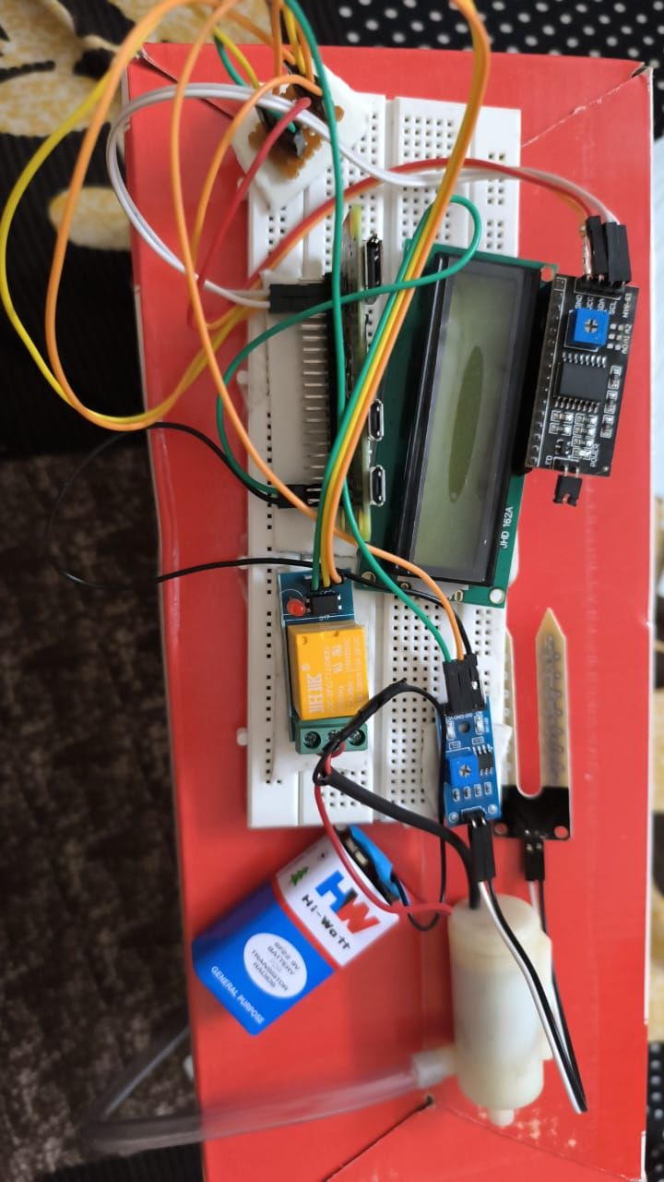
Circuit/Block Daigram

Slide 6
Q&A

Slide 7
Project Timeline
Note: Write in the below table what u will be achieving in each phase
Phase 1
19/12/2023.
By First Phase review we have com pleted all research work related to the components and working of our project
Phase 2
22nd/23^{rd,}03/2024.By 2nd review we have assembled most of our project hardware and would have started on the software side of it
Phase 3
27^{th/28th may,2024}
By 3 rd phase we would have a working model of our project to demonstare our idea in practically

Slide 8
Thank you !!

